Slide 1
Project Numbine

Slide 2
Motivation

Slide 3
Software Development Process
Development
Requirements Analysis
Design
Deployment
Testing

Slide 4
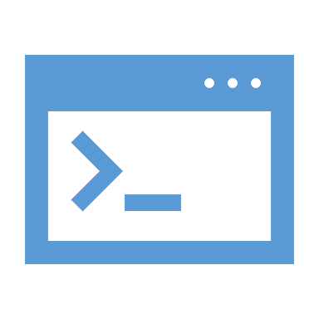


Software Development Process
Development / Testing simulation
Development
Software build 1.0.0.XYZ
Software build 1.0.0.100
Software build 1.0.0.001
Software build 1.0.0.002
Testing

Slide 5
Software Development Process
Some observations
Many repeated cycles of development-testing
Most likely that a test cycle will contain multiple tests
Each single test will take some time to finish
How much testing time do we need in total until a software build is verified?
Development
Testing
It depends on test duration and the total number of tests …

Slide 6
Software Development Process
How much testing time? Example
Let's assume we want to cover every input combination (Full coverage) After all, this is the safest strategy - right?
Software Parameters and Inputs
input 1 … input 10 | Param 1
input 1 … input 10 | Param 2
input 1 … input 10 | Param 3
input 1 … input 10 | Param 4
input 1 … input 10 | Param 5
input 1 … input 10 | Param 6
The total number of input combinations will be 10 x 10 x 10 x 10 x 10 x 10 = 1,000,000 input combinations
Let's assume that a single combination testing will take only 1 minute ( Too good to be true in real life ☺ )
Then in this testing strategy, a single testing cycle will take 1,000,000 minutes ~= 2 years!
Assuming we have 100 “development-testing” cycles then the total testing time will be 200 years!!!
This testing strategy is clearly not feasible

Slide 7
Software Development Process
Conclusion
We need a different testing strategy
The strategy must effectively cover the different test combinations
The strategy must also be time efficient

Slide 8
Software Development Process
The Chosen Strategy - “Pairwise Testing”
The testing strategy that we’re going to focus on is called “Pairwise Testing”
This method* suggests that a software bug is usually caused by:
1 input parameter
Interaction between pair of (2) input parameters
Hence this test strategy suggest to generate and cover all possible pairs of input parameters
(Instead of all possible input parameter combinations)
There are many application that can generate input parameters based on “pairwise” algorithm
For future reference: “PICT” is such application that we will be using
* https://en.wikipedia.org/wiki/All-pairs_testing

Slide 9
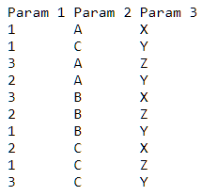
Software Development Process
Pairwise testing strategy - Example
Software Parameters and Inputs
All input combination testing strategy generates 27 tests
Pairwise testing strategy generates 10 tests instead
With pairwise testing, the test input parameters will be:
1 , 2, 3 | Param 1
A, B, C | Param 2
X, Y, Z | Param 3

Slide 10
Software Development Process
Pairwise testing strategy – Will it solve the initial example?
Software Parameters and Inputs
As previously mentioned, the total number of test input combinations possible was 1,000,000
input 1 … input 10 | Param 1
input 1 … input 10 | Param 2
input 1 … input 10 | Param 3
input 1 … input 10 | Param 4
input 1 … input 10 | Param 5
input 1 … input 10 | Param 6
With pairwise testing, the number of test input combination is reduced to 137 only!
Then assuming a test takes 1 minute to run, then with this strategy the testing cycle will take only 137 minutes / 2.28 hours!
This testing strategy is much more realistic

Slide 11
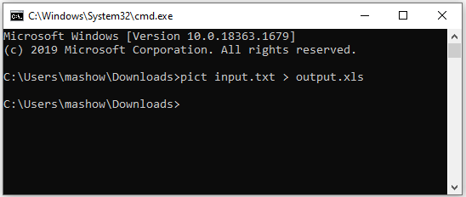
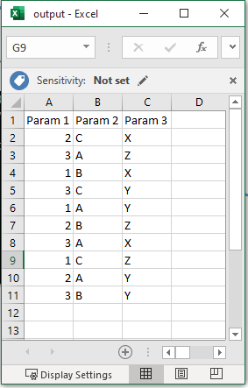
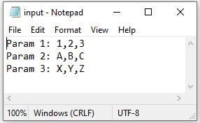
Software Development Process
Pairwise testing strategy – PICT demo
This is the output of PICT Which is the parameters input
Values according to “pairwise”
User create this file which
contain the entire set of
parameters and input values

Slide 12
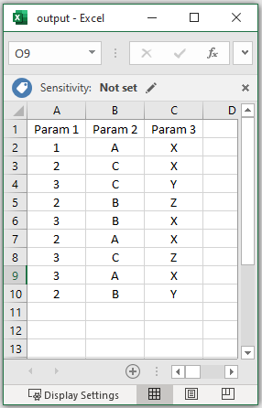
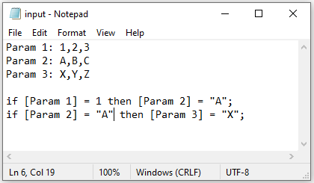
Software Development Process
Pairwise testing strategy – PICT demo with conditions

Slide 13

How is this related to
the project?

Slide 14
The Project

Slide 15
The Project
Introduction
Generally, the project intended to ease test cycles planning of Dell products by using the PICT pairwise tool
How? Well, it will implement a web application that shall:
Integrate the PICT pairwise tool
Store the desired test parameters and their inputs
Store Dell’s products and releases
Link between test parameters/values and Dell’s product/releases
Store PICT pairwise tool output
Thus, given a Dell product/release, the testing parameters/inputs and the PICT tool we will be able to
Manage and generate the desired tests for a given testing cycle

Slide 16


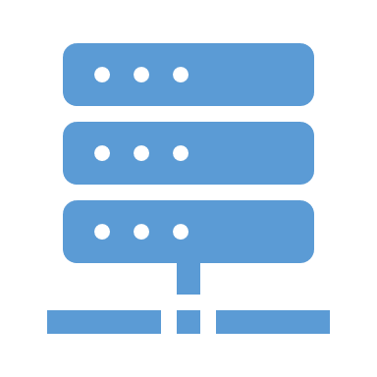
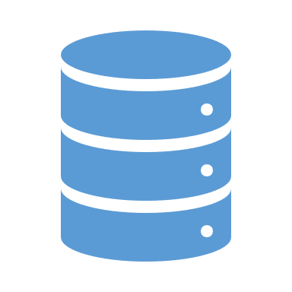

The Project
Introduction – Abstract E2E Simulation
“Store Dell’s products and releases”
“Link between test parameters/values and Dell’s product/releases”
“Store the desired test parameters and their inputs”
“it will implement a web application”
“Integrate the PICT pairwise tool”
Test parameters and inputs
Value 1 … Value N | Param 1
… | …
Value 1 .. Value M | Param X
I’d like to get test input
parameters configuration
for testing cycle X
save input parameter
configuration to DB
Front End
Back End
Dell’s products & releases
send user request
query DB
Release 1 … Release K | Product 1
… | …
Release 1 … Release L | Product Y
return input parameter
configuration to user
User
Works on release 1 of product 1
Test parameter inputs by Dell’s product release
 | Release 1 | Product 1
… | …
.. | Release K
… | … | …
… | … | Product Y
Value … Value | Param
… | …
Value … Value | Param
input parameter
configuration
PICT
return all input parameters
generate input parameter
configuration using
the pairwise algorithm

Slide 17

The Project
Introduction – Abstract E2E Simulation
FYI:
The user is not necessarily a human being
Test parameters and inputs
Value 1 … Value N | Param 1
… | …
Value 1 .. Value M | Param X
The user can also be an automation infrastructure !
Front End
Back End
Dell’s products & releases
Release 1 … Release K | Product 1
… | …
Release 1 … Release L | Product Y
User
Test parameter inputs by Dell’s product release
 | Release 1 | Product 1
… | …
.. | Release K
… | … | …
… | … | Product Y
Value … Value | Param
… | …
Value … Value | Param
PICT
Automation Infrastructure

Slide 18
The Project
Open Questions
Who is responsible for:
Test parameters and inputs
Value 1 … Value N | Param 1
… | …
Value 1 .. Value M | Param X
Filling test parameters and inputs?
Front End
Back End
Filling Dell’s products and releases?
Dell’s products & releases
Linking test parameters and inputs to Dell products and releases?
Release 1 … Release K | Product 1
… | …
Release 1 … Release L | Product Y
User
Adding and managing users?
Test parameter inputs by Dell’s product release
Generating test input parameter configurations?
 | Release 1 | Product 1
… | …
.. | Release K
… | … | …
… | … | Product Y
Value … Value | Param
… | …
Value … Value | Param
This leads us to “user roles”
PICT

Slide 19
The Project
User Roles
“User Roles” is another characteristics of this project
In general, it means that the application will distinguish between different user types
Each user type will have different responsibilities / abilities
Specifically for this project we shall support the following user types:
Configurator
End User
Admin

Slide 20

The Project
Test parameters and input values
User Roles – The “Configurator”
… | …
The configurator main responsibilities is to add/edit/remove:
Product
Dell’s products & releases
Product releases
… | …
Test parameters
Test parameter input values
Test parameter values under product releases
Test parameter inputs by Dell’s product release
Assign test input parameter to product release:
… | … | …
Add test parameter and
parameter input values
Add product and releases:
It goes on and on …
Product 1
Product 1
Product 1
Release 1
Release 2
Release 1
Param 1
Param 1
Product 1
Param 2
Param1
Value 2, Value 10
Value 5, Value 9
Value 3, Value 7
Value 1 … Value N
Release 1 … Release K

Slide 21


The Project
Release | Product | Test cycle | PICT output
User Roles – The “End User”
XLS
Cycle 1
Product 1
Release 1
The end user main responsibilities is to:
Request to generate test input parameter configuration for a product/release for a test cycle (Using PICT)
Note: We don’t remove the product and release – This is for illustration only!
Query
File
Remove
File
Download generated test input parameter configuration from the past
Remove a generated test input parameter configuration
We got the software build to
Be tested at cycle 1!
I’d like to download the test
Configuration parameters to
Start testing.
I’d like to generate test
Configuration parameters for
release 1 of product 1. We’re currently at
Testing cycle 1
The generated file is not
good enough.
I’d like to remove it.
Test parameters and
input values
…
Dell’s products & releases
XLS
…
Test parameter inputs by
Dell’s product release
PICT
…

Slide 22



The Project
Release | Product | cycle | PICT output
… | … | … | …
User Roles – The “Admin”
The admin main responsibilites is to:
Product | Role | Name
Manage users (Add/Edit/Remove users, assign user roles)
Remove
John
Download generated test input parameter configuration from the past from all users he manages
Note: We don’t remove the product. This is for illustration only!
Remove a generated test input parameter configuration which was created by any of the users he manages
We have a new employee
His name is John He is a configurator
He works at Product 1
Test parameters and
input values
We have a new employee
Her name is Emily She is an end user
She works at Product 2
John is no longer working at
The company
remove his user
John
Emily
configurator
end user
Product 1
…
Product 2
Dell’s products & releases
…
Test parameter inputs by
Dell’s product release
PICT
…

Slide 23


The Project
User Roles Hierarchy
The “Admin” is the highest in hierarchy Meaning – He will also be able to perform the “Configurator” & “End user” operations
The “Configurator” is middle in hierarchy Meaning – He will also be able to perform the “End user” operations
The “End user” is lowest in hierarchy Meaning – He can perform his own operations only
admin
configurator
end user

Slide 24
Questions?

